Slide 1




MEDICAL AI ASSISTANT USING YOUTUBE VIDEOS
Presented By:
Saleh Al-Malki
Mohammed Bunahyah

Slide 2

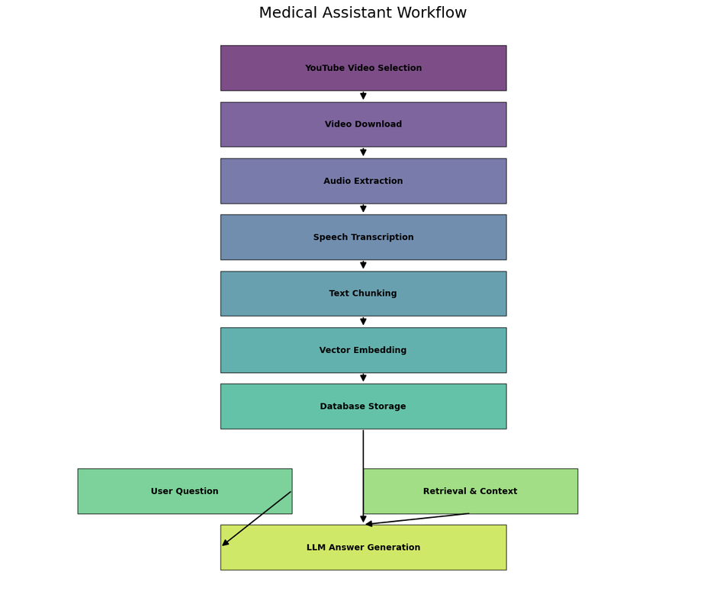
PROJECT OVERVIEW
Objective: Build an AI assistant that answers medical questions by analyzing YouTube videos.
Key Features:
Speech-to-text from videos
Medical question answering
Voice input and output
Vector search for accurate retrieval

Slide 3

SYSTEM ARCHITECTURE
A diagram showing:
YouTube Video
Audio
Whisper (Transcription)
Chunks
QA Engine
Vector DB
Embeddings

Slide 4
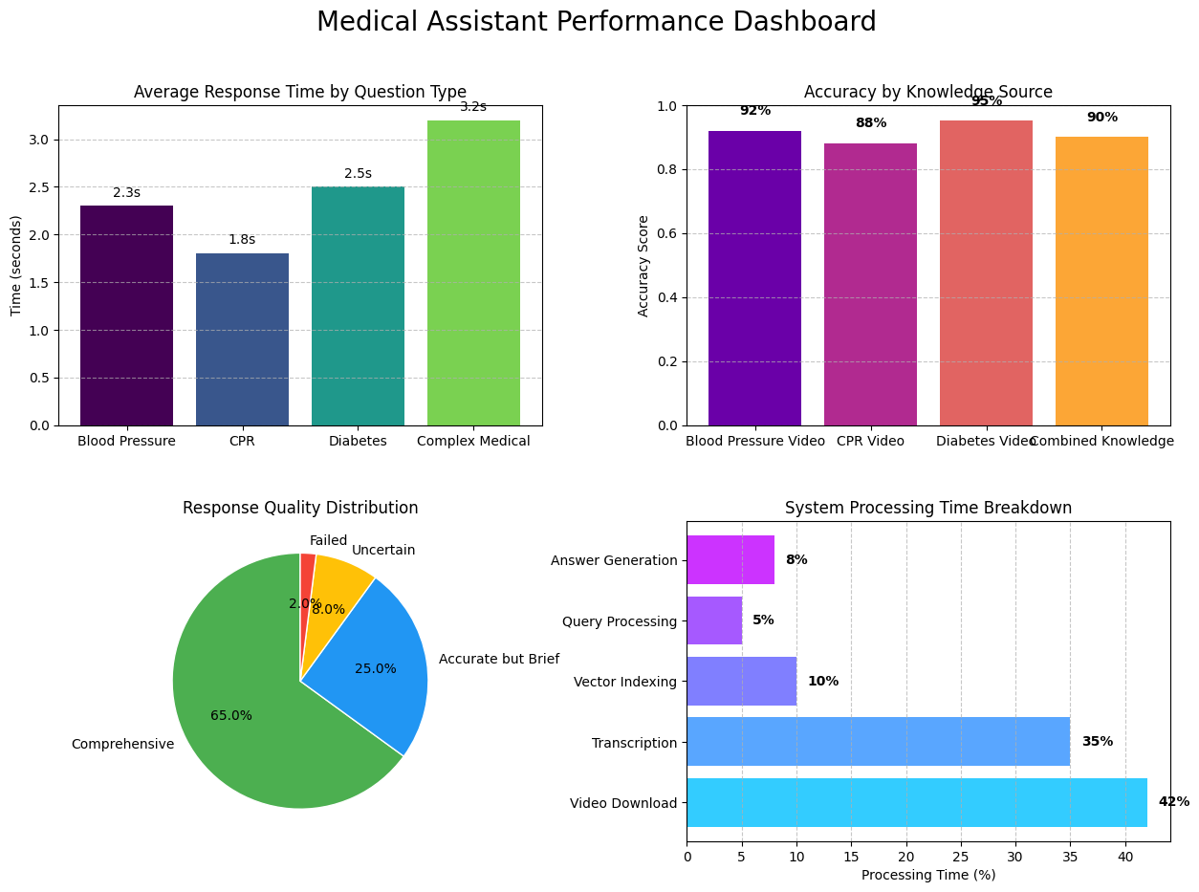
ACCRACY & AVERAGE RESPONSE

Slide 5
TOOLS & TECHNOLOGIES
Category | Tool/Library | Purpose
Speech Processing | OpenAI Whisper | Transcribe audio to text
Language Model | OpenAI ChatGPT | Generate answers
Vector Database | ChromaDB | Store and retrieve vectorized text
Embedding Models | OpenAI / Sentence-Transformers | Convert text to embeddings
YouTube Handling | yt-dlp | Download audio from YouTube
Subtitle Extraction | YouTube Transcript API | Get subtitles as text
Interface | Gradio | Build interactive UI
Monitoring | LangSmith | Track and debug flows

Slide 6
VIDEO PROCESSING
Download audio from YouTube using yt-dlp
Transcribe audio using Whisper
Split text into manageable chunks

Slide 7

VECTOR EMBEDDING & STORAGE
Convert text chunks into embeddings
Store them in a vector database (ChromaDB)
Purpose: enable fast similarity search during Q&A

Slide 8

QUESTION ANSWERING
User submits question (text or voice)
System retrieves the most relevant chunks
A language model (gpt-3.5-turbo) generates the final answer

Slide 9

MULTIMODAL CAPABILITIES
Accepts voice input (converted to text)
Can read out the answer using text-to-speech
Supports both English and Arabic voice/text

Slide 10
CHALLENGES & SOLUTIONS
Large file sizes → solved using chunking
Mis-transcriptions → filtered using keyword relevance
API limits → managed with batching and caching

Slide 11
CONCLUSION
A promising AI system for healthcare content understanding
Easy to use, powerful, and customizable
Bridges the gap between medical video content and user understanding

Slide 12
THANK YOU

